Slide 1
Java Programming
Java Programming IT-11

Slide 2
Understanding Streams
Streams and the New I/O Capability:
A stream is an abstract representation of an input or output device that is a source of, or destination for data.
You can write data to a stream and read data from a stream. You can visualize a stream as a sequence of bytes that flows into or out of your program.
The package that supports stream input/output is java.io.
It defines over seventy classes and interfaces, many of which have a large number of methods.

Slide 3
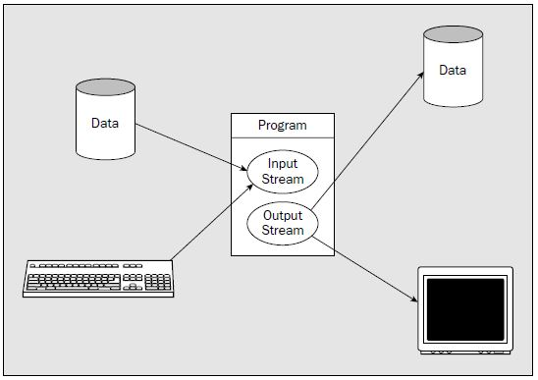
Understanding Streams

Slide 4
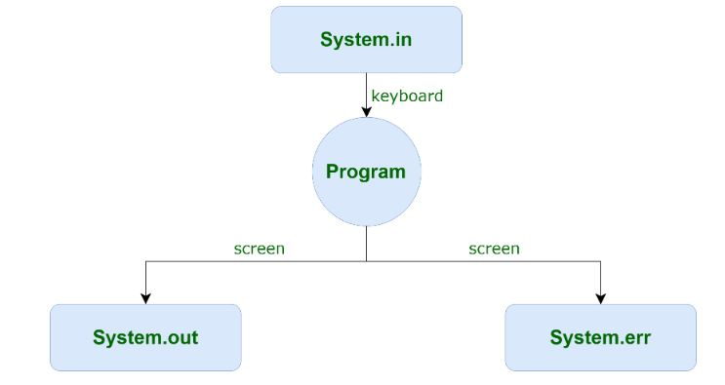
3 standard or default streams

Slide 5
Standard I/O Streams in java
System.in: This is the standard input stream that is used to read characters from the keyboard or any other standard input device.
System.out: This is the standard output stream that is used to produce the result of a program on an output device like the computer screen.

Slide 6
Standard I/O Streams in java
Here is a list of the various print functions that we use to output statements:
print(): This method in Java is used to display a text on the console.
Ex: System.out.print(parameter);
println(): This method in Java is also used to display a text on the console in next line.
Ex : System.out.println(parameter);
printf(): Note that System.out.print() and System.out.println() take a single argument, but printf() may take multiple arguments.
Ex: System.out.printf( "Formatted to "+ "specific width: n = %.4f\n", n);

Slide 7
Standard I/O Streams in java
System.err: This is the standard error stream that is used to output all the error data that a program might throw, on a computer screen or any standard output device.This stream also uses all the 3 above-mentioned functions to output the error data:
print()
println()
printf()

Slide 8
Binary and Character Streams:
The java.io package supports two types of streams—
binary streams or byte strems, which contain binary data, and
character streams, which contain character data.
Character streams are used for storing and retrieving text.
You may also use character streams to read text files not written by a Java program.

Slide 9
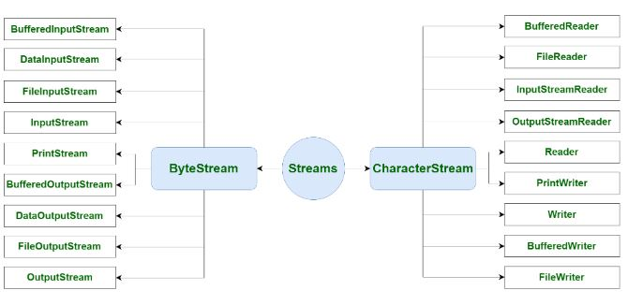
Byte Stream and Character stream classes

Slide 10
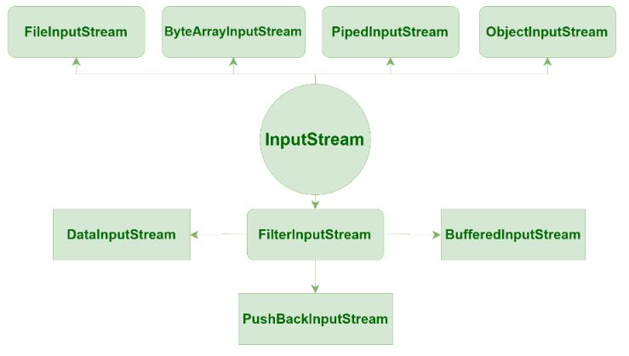
ByteStream Classes
Depending on the type of operations,Byte streams can be divided into two primary classes:
Input Stream: These streams are used to read data that must be taken as an input from a source array or file or any peripheral device. For eg., FileInputStream, BufferedInputStream, ByteArrayInputStream etc

Slide 11
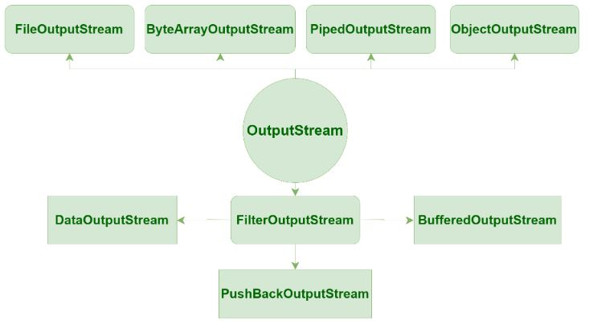
ByteStream Classes
Output Stream: These streams are used to write data as outputs into an array or file or any output peripheral device. For eg., FileOutputStream, BufferedOutputStream, ByteArrayOutputStream etc.

Slide 12
Example
import java.io.*;
class DataInputStreamDemo {
public static void main(String args[]) throws IOException {
try {DataOutputStream dout = new DataOutputStream(new FileOutputStream("file.dat")) ;
dout.writeDouble(1.1);
dout.writeInt(55);
dout.writeBoolean(true);
dout.writeChar('4');
}

Slide 13
Example
catch (FileNotFoundException ex) {
System.out.println("Cannot Open the Output File");
return;
}
try {DataInputStream din =
new DataInputStream(new FileInputStream("file.dat")) ;
double a = din.readDouble();
int b = din.readInt();
boolean c = din.readBoolean();
char d = din.readChar();
System.out.println("Values: " + a + " " + b + " " + c + " " + d);
}
catch (FileNotFoundException e) {
System.out.println("Cannot Open the Input File");
return;
} }}

Slide 14
CharacterStream Classes
CharacterStream: In Java, characters are stored using Unicode conventions (Refer this for details). Character stream automatically allows us to read/write data character by character.
Though it has many classes, the FileReader and the FileWriter are the most popular ones.
FileReader and FileWriter are character streams used to read from the source and write to the destination respectively.

Slide 15
Example
// Demonstrate FileReader.
import java.io.*;
class FileReaderDemo
{
public static void main(String args[]) throws IOException
{
FileReader fr = new FileReader("Firstfile.txt");
BufferedReader br = new BufferedReader(fr);
String s;
while((s = br.readLine()) != null)
{
System.out.println(s);
}
fr.close();
}
}

Slide 16
Example
// Demonstrate FileWriter.
import java.io.*;
class FileWriterDemo
{
public static void main(String args[]) throws IOException
{
FileReader fr = new FileReader("Firstfile.txt");
BufferedReader br = new BufferedReader(fr);
FileWriter f0 = new FileWriter("filewriter.txt");
String s;
while((s = br.readLine()) != null)
{
f0.write(s);
}
fr.close();
f0.close();}}

Slide 17
InputStreamReader Example
import java.io.*;
class InputOutput
{public static void main(String args[]){
try{
InputStreamReader isr=new InputStreamReader(System.in);
BufferedReader br=new BufferedReader(isr);
int a,b,c;
System.out.println("Enter first value");
a=Integer.parseInt(br.readLine());
System.out.println("Enter second value");
b=Integer.parseInt(br.readLine());
c=a+b;
System.out.println("The sum of two no is :"+c);
}
catch(Exception e){}}}

Slide 18
Java File Class Methods
canRead(): boolean
The canRead() method is used to check whether we can read the data of the file or not.
createNewFile():Boolean
The createNewFile() method is used to create a new empty file.
canWrite():Boolean
The canWrite() method is used to check whether we can write the data into the file or not.
exists():Boolean
The exists() method is used to check whether the specified file is present or not.
delete():Boolean
The delete() method is used to delete a file.

Slide 19
Java File Class Methods
getName():String
The getName() method is used to find the file name.
getAbsolutePath():String
The getAbsolutePath() method is used to get the absolute pathname of the file.
length():Long
The length() method is used to get the size of the file in bytes.
list():String[]
The list() method is used to get an array of the files available in the directory.
mkdir():Boolean
The mkdir() method is used for creating a new directory.

Slide 20
Example
// Demonstrate File.
import java.io.File;
class FileDemo
{
static void p(String s)
{
System.out.println(s);
}
public static void main(String args[])
{
File f1 = new File("/JAVA PROGRAMS/file_demo.txt");
p("File Name: " + f1.getName());
p("Path: " + f1.getPath());
p("Abs Path: " + f1.getAbsolutePath());
p("Parent: " + f1.getParent());
p(f1.canWrite() ? "is writeable" : "is not writeable");
p(f1.canRead() ? "is readable" : "is not readable");
}
}

Slide 21
Buffers
All the classes that define buffers have the abstract Buffer class as a base.
The Buffer class therefore defines the fundamental characteristics common to all buffers.
A particular buffer can store a sequence of elements of a given type, and an element can be of any primitive data type other than boolean.
Thus,you can create buffers to store byte values, char values, short values, int values, long values, float values, or double values.
The following classes in the java.nio package define these buffers:

Slide 22
Buffers
ByteBuffer :A buffer that stores values of type byte. You can also store the binary values of any of the other primitive types in this buffer, except for type boolean.
CharBuffer :A buffer that stores only values of type char
ShortBuffer :A buffer that stores only values of type short
IntBuffer :A buffer that stores only values of type int
LongBuffer :A buffer that stores only values of type long
FloatBuffer: A buffer that stores only values of type float
DoubleBuffer: A buffer that stores only values of type double

Slide 23
Buffer Capacity
Each type of buffer stores elements of a specific kind—a ByteBuffer object holds bytes, a LongBuffer object holds integers of type long, and so on for the other buffer types.
The capacity of a buffer is the maximum number of values it can contain, not the number of bytes—unless, of course, it stores elements of type byte.
The capacity of a buffer is fixed when you create it and cannot be changed subsequently.
You can obtain the capacity for a buffer object as a value of type int by calling the capacity()

Slide 24
Creating Buffers
you use a static factory method to create a buffer. You will typically create a buffer object of type ByteBuffer by calling the static allocate() method for the class.
You pass a value of type int as an argument to the method that defines the capacity of the buffer—the maximum number of bytes that the buffer must accommodate.
For example:
ByteBuffer buf = ByteBuffer.allocate(1024);

Slide 25
Buffer Data Transfers
Of course, before you can use a channel to write the contents of a buffer to a file, you must load the buffer with the data.
Methods for loading data into a buffer are referred to as put methods.
These are the methods putChar(), putShort(), putInt(),putLong(), and putFloat(), each of which transfers a value of the corresponding type.Similarly,
when a channel has read data from a file into a buffer, you are likely to want to retrieve the data from the buffer.
In this case you use the buffer’s get methods

Slide 26
Example
double[] data = { 1.0, 1.414, 1.732, 2.0, 2.236, 2.449 };
doubleBuf.put(data);

Slide 27
Channels
a channel transfers data between a file and one or more buffers.
A considerable number of classes and interfaces define both channels and buffers. They also have similar names such as ByteBuffer and ByteChannel.
File Channels:
For reading, writing, and manipulating the file. You can’t create a FileChannel directly.
You first have to create a file stream object for the file, then obtain a reference to the FileChannel object for the file by calling the getChannel() method for the file stream object.
FileChannel outputChannel = outputFile.getChannel();

Slide 28
Writing to a File
For example, if you have set up a ByteBuffer buf, ready to be written,
ByteBuffer buf = ByteBuffer.allocate(80);
you might code the write operation like this:
File aFile = new File(“C:/myFile.text”);
FileOutputStream outputFile = null;
try {
outputFile = new FileOutputStream(aFile);
} catch (FileNotFoundException e) {}
FileChannel outputChannel = outputFile.getChannel();
try {
outputChannel.write(buf);}
catch (IOException e) {}

